Slide 1


Graphics
Images within 2D games
Part 6 – Ribbons

Slide 2

Image Ribbons
Building a scrollable background using several ‘joined’ images

Slide 3
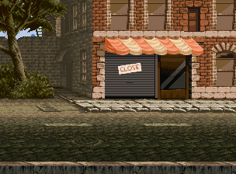
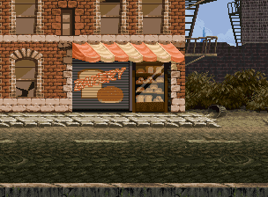
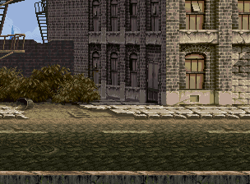
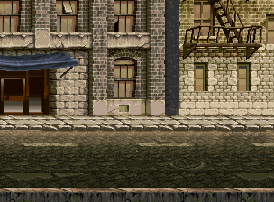
An image ribbon is a sequence of connected images (1+) (maybe looped)
A moveable viewport (i.e. the corresponding game object size) onto the ribbon is maintained
Ribbons can be a good way of handling backgrounds in a scroller/platform game
Viewport

Slide 4
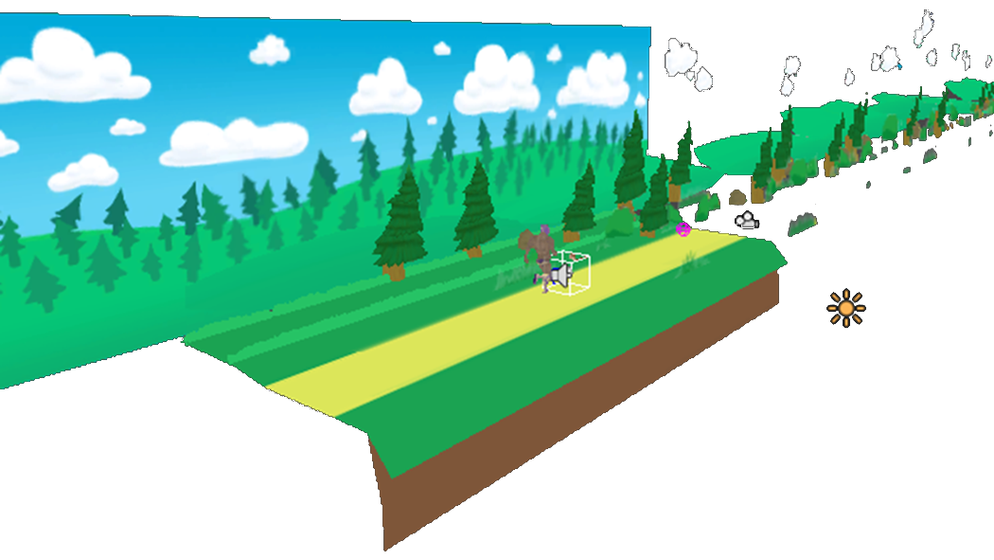
Ribbons are commonly used to provide the ‘illusion’ of a moving background
Game objects are given a position within the world.
A background is always drawn and scrolls as the camera moves.

Slide 5
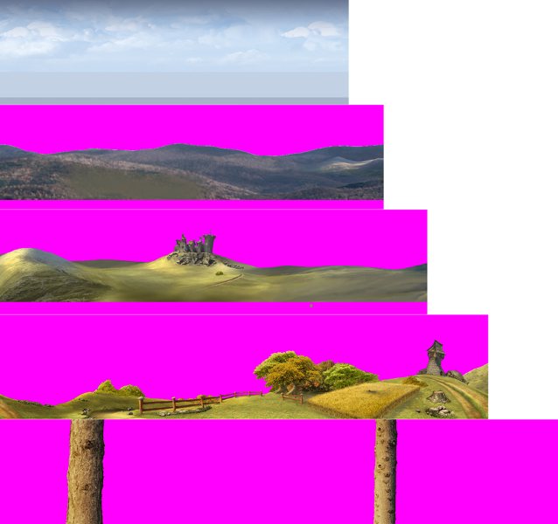

Using several different ribbons that move (rotate) at different speeds can provide a good appearance of scene depth (due to a parallax effect).
Constantly scroll by 2
Offset by 1
Offset by 5
Offset by 10
For example: Player moves 20 on screen pixels
Offset by 20

Slide 6
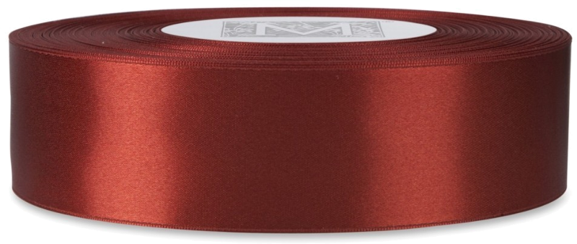
Looping a single ribbon

Slide 7
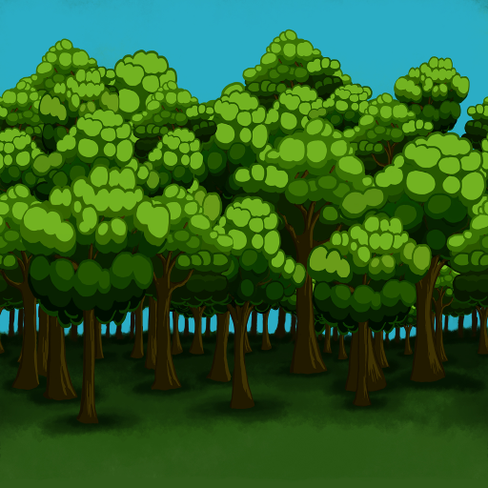
Assume a viewport has the same height and a smaller width than an background ribbon. How can the ribbon be drawn to provide a seamless scrolling background?
height
viewportX, viewportY
Sometimes two segments of the ribbon will need to be stitched together.
viewportWidth
ribbonWidth
Start
10 mins
9 mins
8 mins
7 mins
6 mins
5 mins
4 mins
3 mins
2 mins
1 min
30 sec
Finished

Slide 8
Imagine the ribbon repeated along the x-axis.
The index of the first visible copy of the ribbon is:
1 | (int)(viewPortX-viewportWidth/2) / (int)ribbonWidth
2 | // Integer maths will usefully truncate here.
This can then be drawn as any other object. A second draw is needed if the end position of the drawn ribbon image is less than right hand side of the viewport.

Slide 9

Looping lots of images

Slide 10



Given the following:
n images ( I₁ … I_{n}) with the same height, h, but different widths (w₁ … w_{n})
imageOffset[n] holds the x start offset of image n, and the first image starts at x = 0
A viewport of height h ranges between x values v_{S} to v_{E}
Develop an algorithm that works out which bits of which images should be displayed as they fall within the viewport. Assume the image strip loops around on itself.
I₁ w₁
I₂ w₂
I_{n} w_{n}
Start
h
10 mins
9 mins
8 mins
7 mins
6 mins
5 mins
4 mins
3 mins
2 mins
1 min
30 sec
Finished
x=0, y=0
x = x_{VS}
x = x_{VE}

Slide 11

drawHorizontalRibbon() {
int viewPortOffset = viewPortX;
int drawOffset = 0;
int imageIdx = 0;
int drawWidth;
viewPortOffset – viewport start draw offset relative to ribbon
h
x=0, y=0
drawWidth – width to draw across ribbon
drawOffset – start draw offset relative to viewport

Slide 12
drawHorizontalRibbon() {
int viewPortOffset = viewPortX; int drawOffset = 0; int imageIdx = 0; int drawWidth;
while(imageOffsets[imageIdx +1] < viewPortX )
imageIdx++;
viewPortX – viewport start relative to ribbon
h
x=0
imageOffsets[0]
imageOffsets[1]

Slide 13
drawHorizontalRibbon() {
int viewPortOffset = viewPortX; int drawOffset = 0; int imageIdx = 0; int drawWidth;
while(imageOffsets[imageIdx +1] < viewPortX )
imageIdx++;
while( drawOffset < width ) {
drawWidth = imageOffsets[imageIdx+1] - viewPortOffset;
if( drawOffset + drawWidth > width )
drawWidth = width - drawOffset;
Case 1: Image fully within viewport
Case 2: Image not fully within viewport

Slide 14
drawHorizontalRibbon() {
int viewPortOffset = viewPortX; int drawOffset = 0; int imageIdx = 0; int drawWidth;
while(imageOffsets[imageIdx +1] < viewPortX )
imageIdx++;
while( drawOffset < width ) {
drawWidth = imageOffsets[imageIdx+1] - viewPortOffset;
if( drawOffset + drawWidth > width )
drawWidth = width - drawOffset;
drawToScreen(…)
(drawOffset, 0)
(drawOffset+drawWidth, height)

Slide 15
drawHorizontalRibbon() {
int viewPortOffset = viewPortX; int drawOffset = 0; int imageIdx = 0; int drawWidth;
drawOffset += drawWidth;
viewPortOffset = (viewPortOffset + drawWidth) % imageOffsets[numImages];
imageIdx = (imageIdx+1) % numImages;
}
}
old viewPortOffset
new viewPortOffset
drawWidth
old drawOffset
new drawOffset

Slide 16

Key takeaways:
Image ribbons provide a very capable means of providing backgrounds within games

